Slide 1
Electronics Lab (Experiment-1B)
P . Manoj Kumar
Roll no : 21IE10027

Slide 2
Design a Simple Common Emitter Amplifier
Objective of the Experiment
Use the model parameters to design a simple common emitter amplifier.
Simulate performance of the amplifier.

Slide 3
Theory
A common emitter amplifier is a configuration in which the base is the input terminal and collector is the output terminal. The emitter is common for both input and output terminals.
The gain of the amplifier depends on the transconductance of the BJT and the total output resistance of the circuit.

Slide 4
List of Components
SL No. | Component | Rating | Quantity
1 | BJT Transistor | 2N2222 | 1
2 | Voltage Source | 12V , 100m AC | 2
3 | Resistors | 1K𝛺 , 5K𝛺 , 1585K𝛺 | 3
4 | Capacitors | 5µF | 2
5 | Connecting wires | - | -

Slide 5
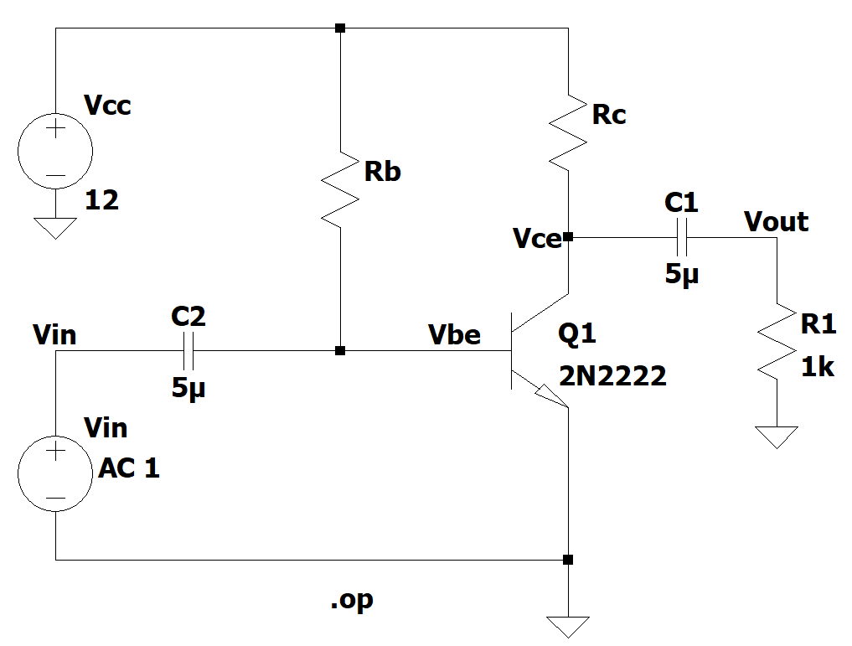
Circuit Diagram
Fig–1.1-Common Emitter configuration with unknown R_{b} and R_{c}

Slide 6
Procedure
The given circuit was created on LTSpice.
The values of R_{b} and R_{c} was adjusted so that such that IC is in the range of 1-2mA (nearly 1.5 mA)and V_{ce} is around 6V.
The operating point was measured.
The values of gain at 1KHz was found by the AC analysis of the amplifier.
The input-output characteristics was plotted by exciting the circuit using 1KHz ramp input.

Slide 7


Values of R_{b} and R_{c}
The value of R_{c} wil be nearly = $\frac{\text{V}\text{cc}\text{−}\text{Vc} }{\text{I}\text{c} }= \frac{12−6}{0.0015}=4KΩ$
R_{b} (in $KΩ$) | V_{ce}( in volt)
500 | 0.128733
700 | 0.176792
1000 | 2.8165
1400 | 5.26318
1500 | 5.68369
1585 | 6.00187

Slide 8
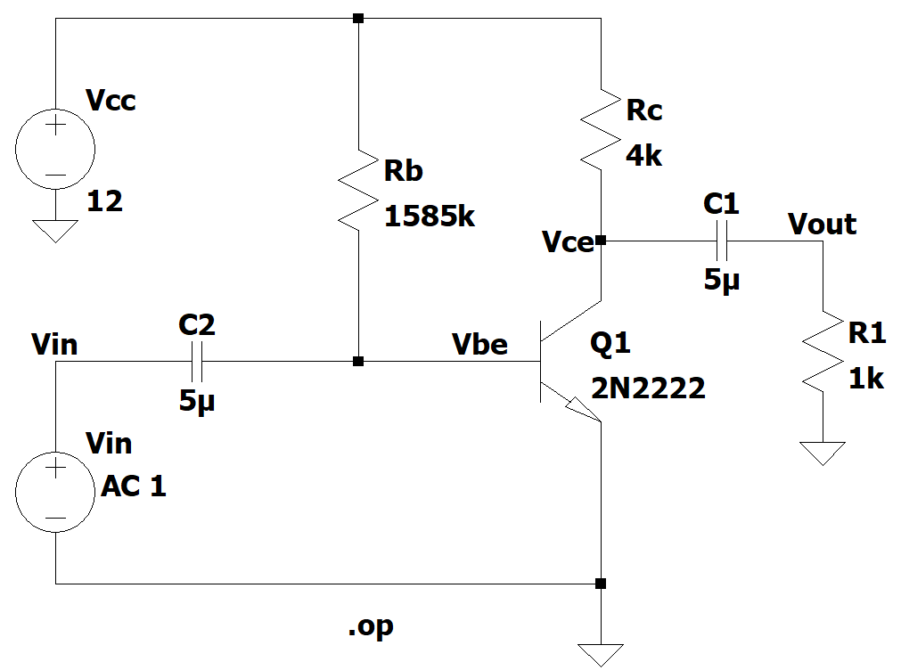
Circuit Diagram (After Biasing)
Fig-1.2-Common Emitter configuration after adjusting the operating point
R_{b}=1585K𝛺 and R_{c}=4K𝛺

Slide 9
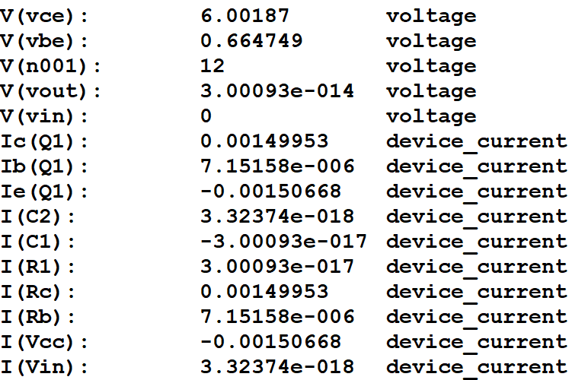
Operating point analysis
Fig-1.3-Operating point values of the common emitter amplifier
V_{ce} = 6V and I_{c} = 1.5mA

Slide 10
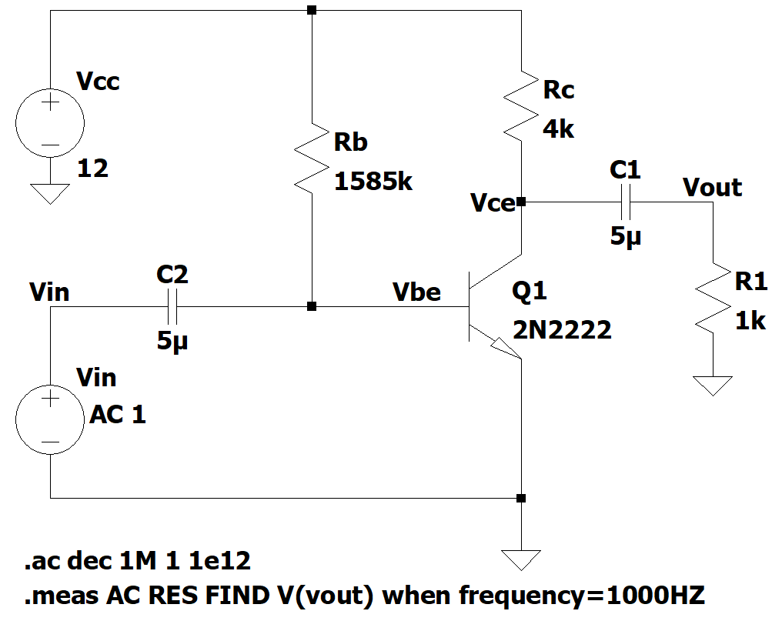
Observing Gain(V/V) at 1KHz Frequency
Fig-1.4-Frequency response of the common emitter amplifier
After running the above command , the output will be res: v(vout)=(33.0615dB,-179.123°) at 1000.
The gain is 33.0615dB and the phase of gain is -179.123°.

Slide 11
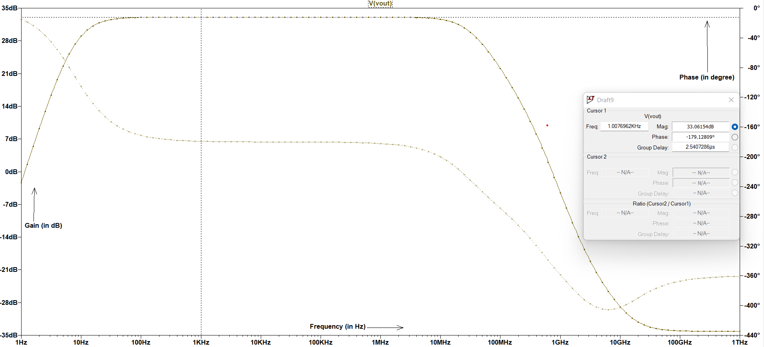
Small Signal AC analysis (Gain and Phase Plot)

Slide 12
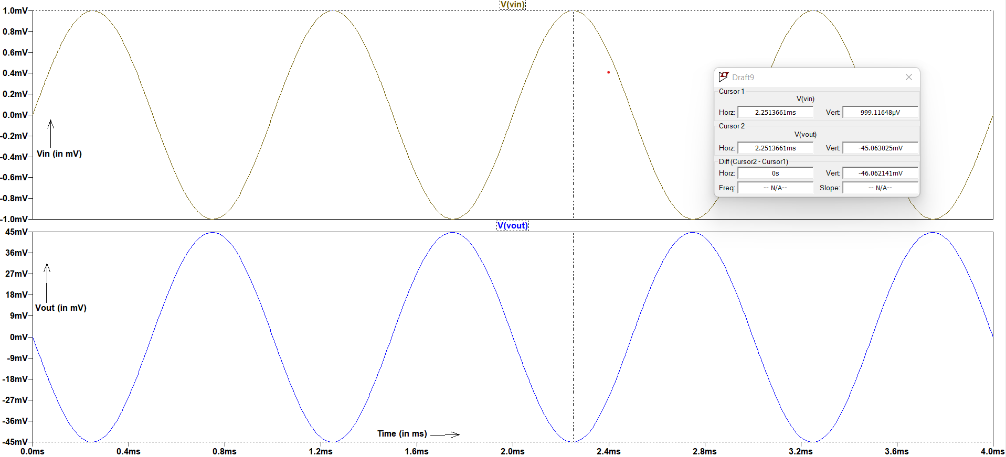
Verification of Gain using a Sinusoidal Input Signal
Fig-1.5-Input and Output waveforms

Slide 13

Calculations
The maximum output signal swing = $\frac{\text{V}\text{cc}\text{−}\text{Vc}}{2}$
= $\frac{12−6.00187}{2}$ V
= 2.999065 V

Slide 14
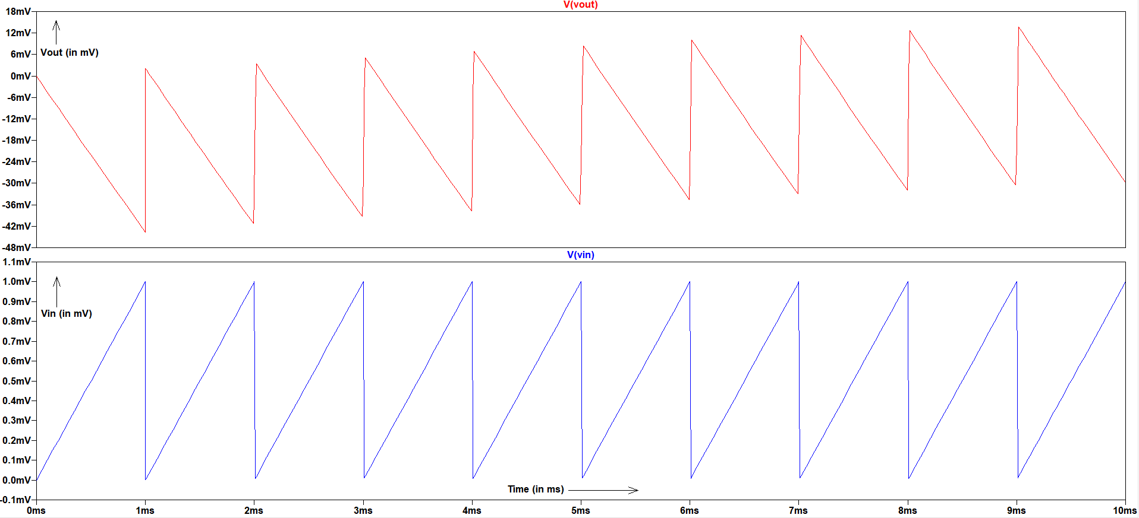
Input and Output Waveforms
Fig-1.5-Output waveform and Input Waveform (1KHz ramp input)
The 1KHz ramp input can be given as PULSE(0 1m 0 1m 0 0 1m 10).From the graph this can be concluded that
The gain is negative and the output signal is nearly 180° out of phase with input signal.

Slide 15
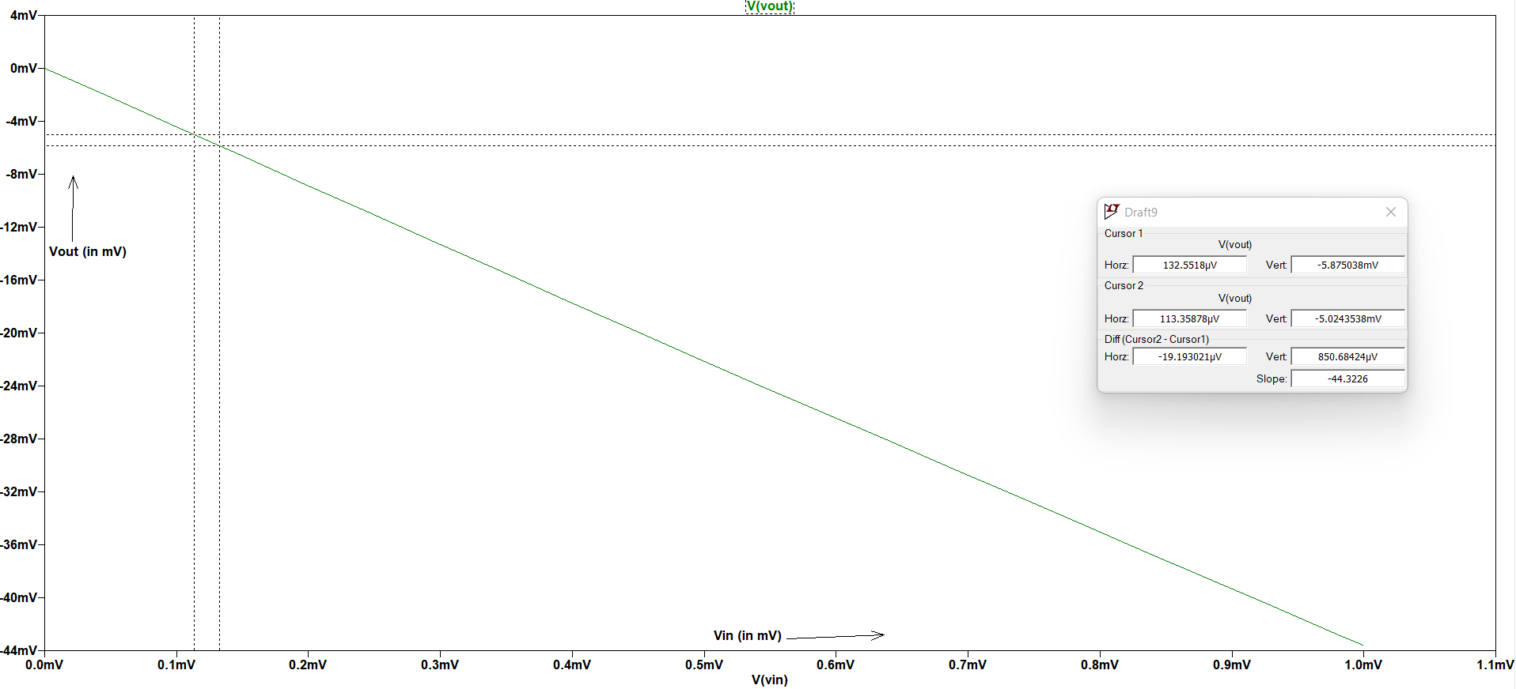
Input to Output Characteristics
Fig-1.6-Input to Output characteristics for a 1KHz ramp input
This characteristics can be obtained by taking single ramp signal (only one pulse).
The plot is linear having slope of -44.3226 (V/V).
The gain (in dB) = 20log(44.3226) = 32.9325dB ( nearly equal to which was obtained from AC analysis )

Slide 16
Observations
The gain of the amplifier is nearly constant (maximum)from 100Hz to 10MHz and the phase of the gain changes from -15° to -360°.
The change in coupling capacitance will not affect the gain when the frequency is in the above range and at other frequencies , the increase in frequency increases the gain.
We can conclude that increase in coupling capacitance decreases the cut-off frequency.

Slide 17
Thank You !

